Slide 1
Agriculture management system
Group No – 06
Miss. Anuradha Shivaji Sangale(TL) - 210543181009
Miss. Varsha Bhaskar Pawar – 210543181069
Mr. Vilas Nagoji Oulkar – 210543181057
Mr. Akash Shivkumar Bhosale - 210543181014

Slide 2
Abstract
Agriculture management system is to help farmers by providing all kind of agriculture related information on the website. Agriculture management system is farmer management website application which help farmers to give best practice farming processes. It helps farmers to improve their productivity and profitability. It enables farmers buy products through online and farmers can purchase tools and seeds. Farmers can view labors profile and they can hire labors.

Slide 3
Introduction
Agriculture management system is the web application that will help the farmers to perform the agro marketing leading to achieve and increase in standard of living
Website will also provide market-wise, commodity-wise report to the farmers in interactive way.

Slide 4
Objectives
The main objectives of this project is building a website which will help farmers from Indian villages to sell their product to different city markets.
This website will act as unique and secure way to perform agro-marketing, purchasing.
The site will guide the farmer’s in all the aspects, the current market rate of different product, the total sale and earned profit.

Slide 5
Existing system
There is no computerized system to buy their products, currently the farmer goes to nearest market and handover his product to a particular agent.
Many times, farmers are not even aware of the schemes and compensation provided by government.
Current system does not provide the way of e-learning for farmer that will provided the knowledge of new technique in farming.

Slide 6
Proposed system
It is an computerized system for the farmer’s buy products through a single site.
It provided an awareness to the farmer’s about the various schemes provided by the government.
It provides all new agriculture ideas to the farmer’s.

Slide 7
Advantages
All the facilities are available in single website.
Farmer’s can get information about all the agricultural related items.
People can buy the agriculture products directly without an agent.

Slide 8
Disadvantages
Internet connection is must.
People should be aware of the new technologies.

Slide 9
Software requirement
Apache Server 8.5
MySQL 5.7 with Workbench 8.0
Browser: Google chrome, Mozilla Firefox etc

Slide 10
Hardware
Operating System:
Windows 7/8/8.1/10
Processor: Intel Core i3
RAM: 1GB or more
ROM: 500MB or more
Data Connection 200 kbps

Slide 11
Languages Used
Front end: HTML, CSS, Bootstrap, Thymeleaf
Backend: Java, JavaScript, JDBC Driver
Database: MySQL Server

Slide 12
Future Scope
Agriculture management system can be implemented by using satellites. With help of satellite communication user can observe the climatic conditions of the farm even by sitting at home.
Government will put forward the new schemes for the farmers. Unique interface will be provided for applying and viewing the schemes.

Slide 13
Conclusion
Finally this system gives more benefits to the farmers. Without going to the market they can buy products by sitting at home also. It acts as an interface to the farmer to do their work easily.

Slide 14
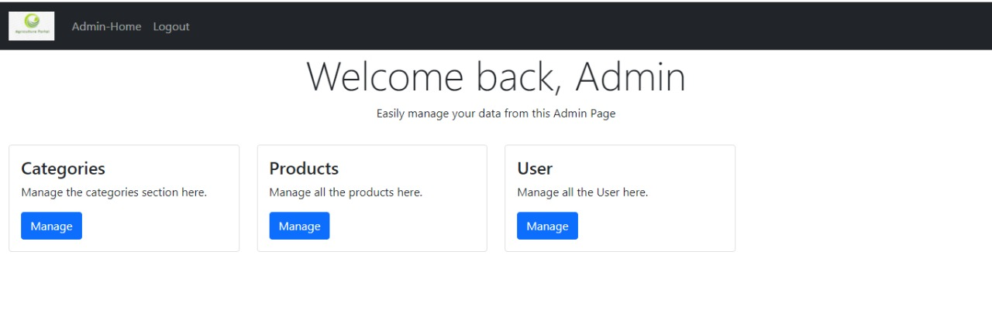

Slide 15
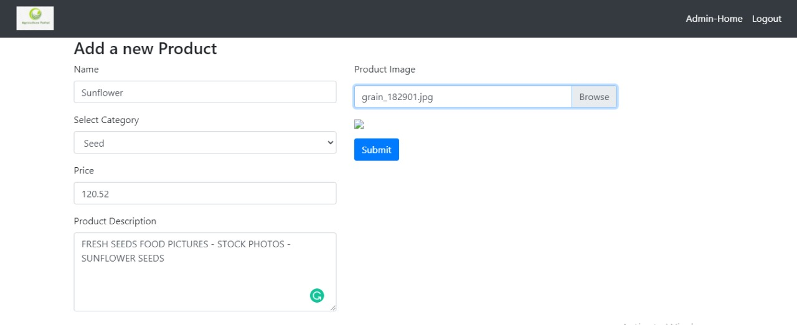

Slide 16
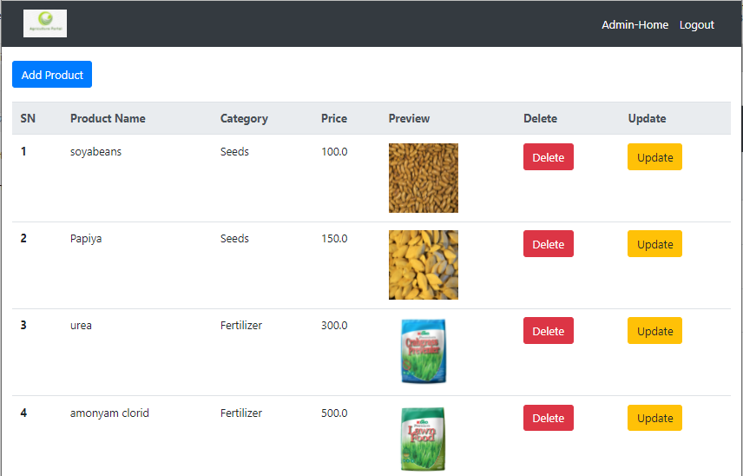
Admin Product Page

Slide 17
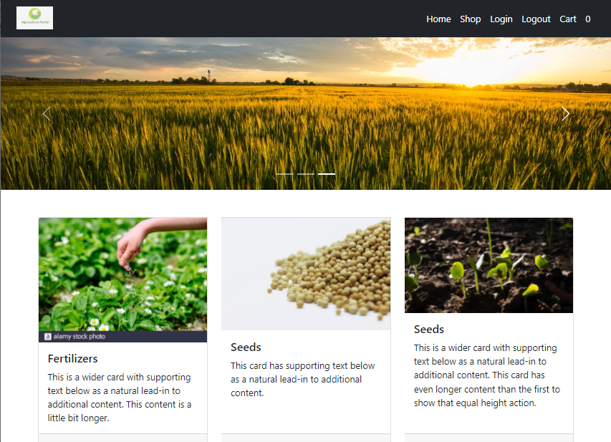
User Home Page

Slide 18
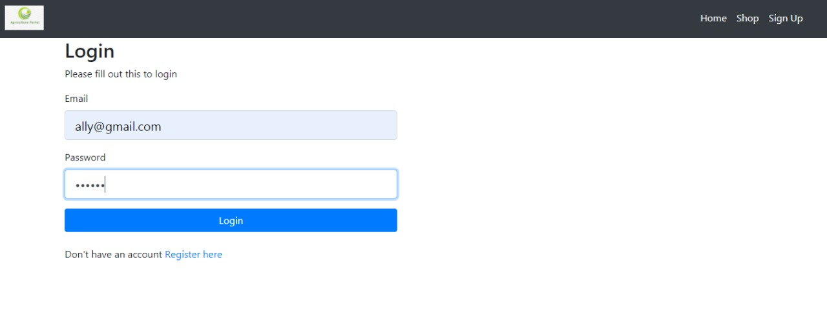

Slide 19
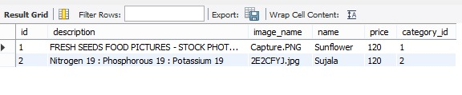

Slide 20
Thank You!!

